Slide 1
CHRIST THE KING
ENGINEERING COLLEGE
Project Members
GOKULAVASAN-710419105013
G. L. JAI PURUSHOTHAM RAJ-710419105017
SARANRAJ-710419105033
SURESH. R-710419105037
R. YOGESH-710419105043
Project Presentation
EE8611-MINI PROJECT
(UG – THIRD YEAR)
Under the guidance of
Mr. D. Citharthan
Associate Professor
Department of Electrical and Electronics Engineering
Christ the King Engineering College
Coimbatore 641 104
Date : 25-06-2022
DEPARTMENT OF
ELECTRICAL AND
ELECTRONICS ENGINEERING

Slide 2

Batch No : P 01
CONDITION MONITORING OF MACHINE TOWARDS NET ZERO ENERGY PATH

Slide 3
Presentation Outline
ABSTRACT
INTRODUCTION
LITERATURE REVIEW
PROBLEM STATEMENT
CKEC ENERGY AUDIT REPORT
CARBON FOOTPRINT CALCULATION
IMPACT OF LOADS IN ENERGY CONSUMPTION
ECOs
CIRCUIT DIAGRAM
PROPOSED METHODOLOGY
FFT
12) FUTURE SCOPE
13) CONCLUSION
14) REFERENCE

Slide 4
ABSTRACT
The coal reserves at India’s power plants have declined almost 17% since April. Hence there is a crucial shortage in the availability of the coal
For the generation of electricity, we need to burn the coal, which pollutes the environment
We need to undergo remedial measures for these problems like attaining net zero energy path. Net zero energy path can be defined as the total amount of energy we produce to the amount of energy we consume.
GEP is a very important ECO, which can be followed to attain the NET ZERO ENERGY PATH
Vibration analysis of motor is done, which comes under the predictive maintenance of GEP
From the vibration signals, based on the frequency domain obtained, we can able to identify the type of fault and based on the amplitude, we can able to obtain the severity of the fault.
Because of this technique, we can prevent the equipment from being damaged and also can prevent the excessive power consumption because of the fault.
Thus, the vibration analysis of the motor will be one of an effective solution to attain the net zero energy path.

Slide 5
OBJECTIVE
The main objective of this project is to attain the NET ZERO ENERGY PATH
Net Zero Path can be obtained by following GOOD ENGINEERING PRACTICES
In this project, Vibration analysis of machines are done, which comes under the predictive maintenance of GEP
By doing this Vibration analysis, we can able to predict the fault occurring on the machine before it occurs, so that, we can able to prevent the excess of power consumption because of the fault by which, we can attain the NET ZERO ENERGY PATH
By saving the power consumption, we can control the CO2 emissions into the atmosphere indirectly

Slide 6



INTRODUCTION
Increased Comfort Level
HIGH ENERGY CONSUMPTION
INCREASE IN CO2 EMISSION

Slide 7
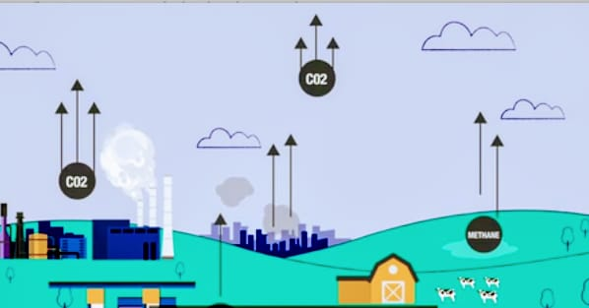
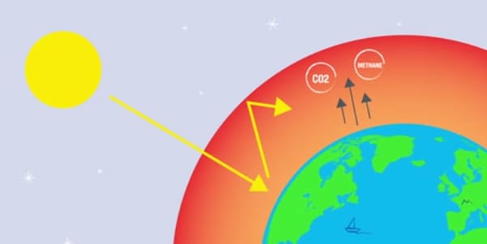


Contd..,
1
2
EXCESS OF CO2 AND METHANE IS EMITTED TO THE ATMOSPHERE
THESE EMITTED GASES TRAP THE HEAT FROM THE SUN WHICH WARMS OUR PLANET MORE
4
3
NET ZERO IS THE BALANCE BETWEEN THE AMOUNT OF GREENHOUSE GAS WE EMIT WITH THE AMOUNT WE TAKE OUT
THIS MAY LEAD TO ABNORMAL CLIMATIC CHANGES IN OUR PLANET

Slide 8
LITERATURE REVIEW
Investigator | Description | Year
A.Ajitha D.Swathi J.Laxmi Prasanna D.Shyamala | This paper focusses on the monitoring of the Industrial motors using IOT technology. In this, Vibration sensor, temeprature sensor, current sensor were connected with the industrial motor. The obtained data from the sensor will be transferred to the thingspeak, an IOT Cloud platform were analog data were fetched. By the obtained data, the fault of the industrial motor can be predicted. | 2017
Atharva Joshi Niyati Khandelwal Yash Suryavakshi Maya Kurulekar | This paper mainly focusses on the energy consumption of the building by undergoing energy audit. The Carbon footprint was also calculated based on the obtained energy audit report. By the energy audit report and by the use of softwares, certain measures were suggested, | 2016
Pana Chupan Boonlert Suechoey Somsak Siriporananon | This paper presents the monitoring of machine condition by vibration analysis by analysing the vibration signals under the guidelines ISO 10816-3 Standards, faults were predicted, which comes under the predictive maintanence of the Good Engineering Practices. | 2019
Rakesh A. Patel Bhavesh Bhaljia, MD Aftab Alam | It shows unique technique to find the rotor and bearing fault in the 3 phase induction motor, by conducting the current analysis and the vibration analysis. With the help of MATLAB, Vibration and the current signals were analysed to find the condition of the equipment. Later, it was integrated with the AI and continuesly monitoring the machine to identify the condition of the motor. | 2022

Slide 9
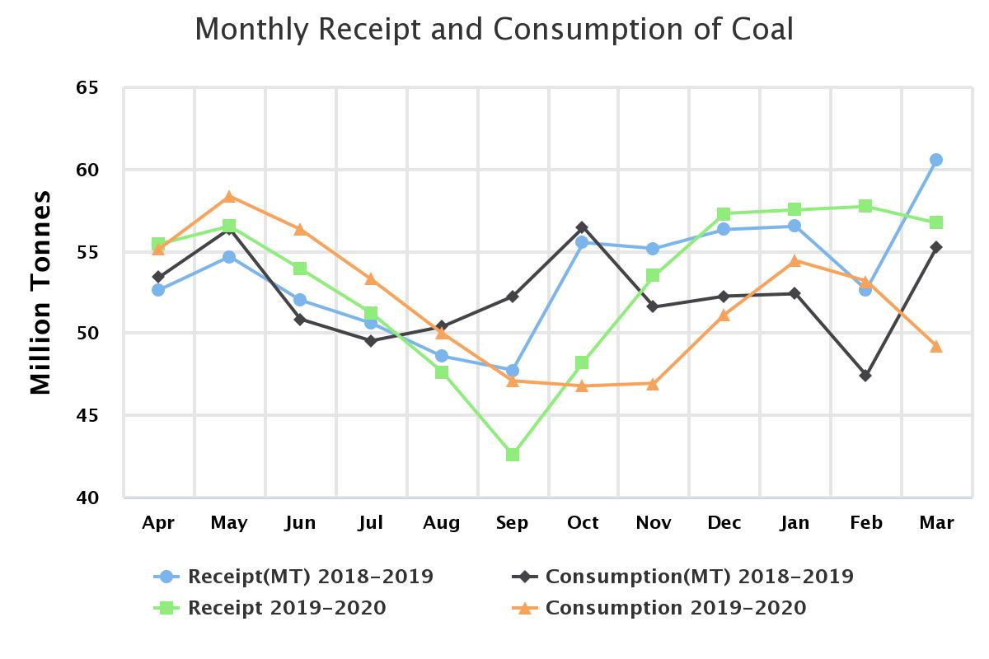

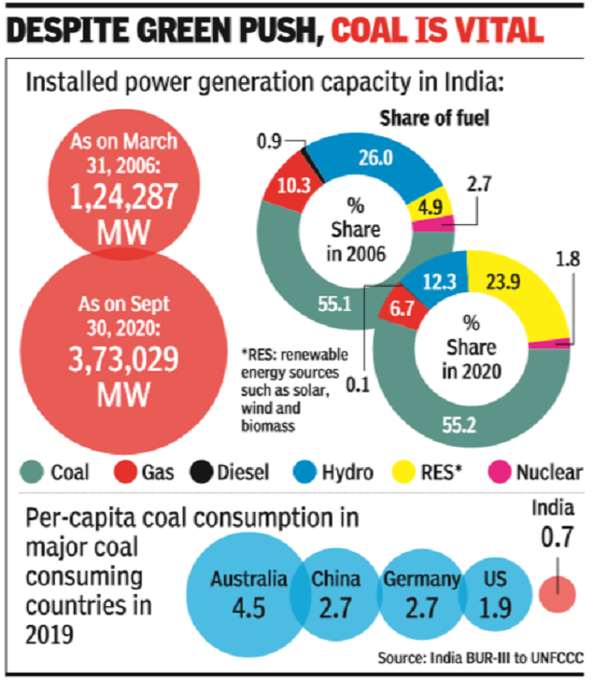
PROBLEM STATEMENT
The demand for the coal is rapidly increasing in India
We couldn’t completely switch on to the renewable energy resources
By not following GEP in electricals, it paves a way for the increase in power consumption

Slide 10
CKEC ENERGY AUDIT REPORT

Slide 11
LOADS→ | FAN |  | LIGHT |  |  |  | AC | COMPUTER | PRINTER | WATER DOCTOR | OTHER
NAME OF BLOCKS | CL | TF | FL | LED TL | LED | CFL |  |  |  |  | SPEAKER | MOTOR | LAB EQIP | WATER HEATER
XAVIER’S BLOCK | 112 | 3 | 137 | 2 | 6 | 28 | 19 | 188 | 11+1(X) | 2 | 8 |  | -
ALPHONSA BLOCK | 68 | 10 | 44 |  |  |  |  | 7 | 2 | 1 |  |  | 56
MOTHER VIRGIN AUDITORIUM | 46 |  | 38 | 6 (100W)
St.SEBASTIAN’S BOYS HOSTEL | 122 | 1 | 60 | 10 | 10 |  |  |  |  | 1 |  |  | 20 | 2
St.JOSEPH’S BOYS HOSTEL | 107 |  | 6 |  | 70 | 10 |  |  |  | 1 |  | 1(gr) 2-fr |  | 2
St. MARY’S GIRLS HOSTEL | 50 |  | 35 |  | 49 | 3 |  |  |  | 1 |  |  |  | 1
ADMINISTRATOR BLOCK | 45 |  | 43 | 8 |  |  | 6 | 10 | 5+1(X) | 1 | 2 | 1(MI) |  | 2-Fr, 3-w,1-ir
CANTEEN | 7 |  | 12 |  | 3
WORKERS ROOM | 19 |  | 27 | 5 | 2
TOTAL | 576 | 14 | 402 | 31 | 87 | 41 | 25 | 205 | 20 | 7 | 10 | 4 | 76 | 13

Slide 12
CARBON FOOTPRINT CALCULATION
MEASURE CKEC CARBON FOOT PRINT (ELECTRICITY)
Electricity = 0.85 kg CO₂ per KWh, Source: CO₂ emission factor database, version 06, CEA (Government of India)
MONTH / YEAR | Energy Consumption in CKEC/ month (KWh) | CO₂ EMMITING PER KWh | Co2 emission from Electricity in CKEC in month (KG)
SEPTEMBER - 2021 | 11310.4 | 0.85 | 9,613.84
OCTOBER - 2021 | 12955.6 | 0.85 | 11,012.26
NOVEMBER - 2021 | 14078.8 | 0.85 | 11,966.98
In the year of 2021 ELECTRICITY CONSUMED BY CKEC (Approx.) = 153379.2 KWh
Co2 Emission per year = 1,30,372.32 Kg

Slide 13
CARBON FOOTPRINT CALCULATION
2.MEASURE CKEC CARBON FOOT PRINT (TRANSPORT)
Petrol: Input Value(In Liters/Yr) X 2.296(Emission Factor) = Output value in (Kg of CO₂ ) 300 liters/year X 2.296 = 688.8 Kg of CO₂
Diesel: Input Value(In Liters/Yr) X 2.653 (Emission Factor) = Output value in (Kg of CO₂)
20,160 liters/year X 2.653 = 53,484.48 Kg of CO₂
In the year of 2021 Total Co2 Emitted by Fuel = 54,173.28 Kg

Slide 14
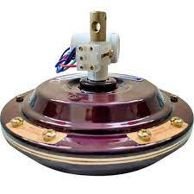
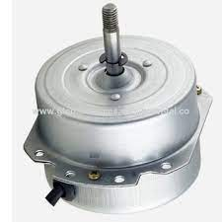
IMPACT OF LOADS IN ENERGY CONSUMPTION
1
FAN
Total number of Single Phase Induction motor fans (ceiling fans) in CKEC = 576
Power consumed per ceiling fan = 70 W/hr
Total Power consumption = 576 X 70 = 40,320 W/hr
Now, If we replace this single phase Induction motor fans into BLDC (Brushless DC) Motor fans,
Power consumed per BLDC fan = 30 W/hr
Total Power Consumption from BLDC fan = 576 X 30 = 17,280 W/hr
If we use BLDC fans in CKEC, we can save up to = 48960 – 17280 = 23,040 W/hr

Slide 15
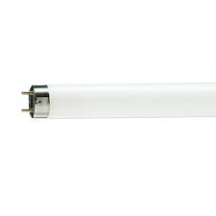
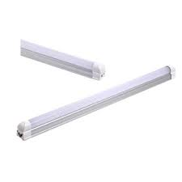
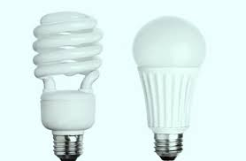
2
Light
I) Fluorescent Tube Lights
Total number of Fluorescent Tube lights in CKEC = 402
Total Power consumed per Tube light = 40 W/hr
Total Power Consumption = 16,080 W/hr
Power Consumed per LED tube lights = 22 W/hr
Total Power consumption = 8,844 W/hr
Save up to 7236 W/hr from Tube lights
II) Compact fluorescent lamps (CFL)
Total number of CFL in CKEC = 41
Total Power consumed per CFL = 15 W/hr
Total Power consumption = 615 W/hr
Power Consumed per LED Bulb = 9 W/hr
Total Power consumption = 369 W/hr
Save up to 246 W/hr from CFL
If we use LED Tube lights and LED bulbs in CKEC we can save up to = 7236+246= 7482 W/hr

Slide 16
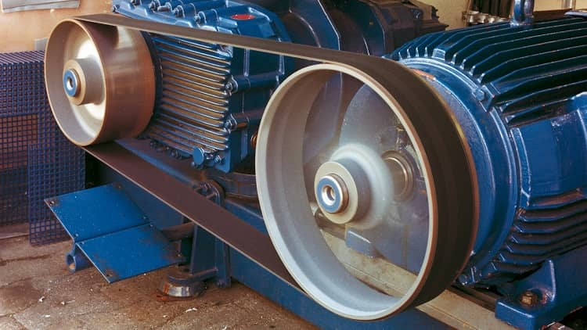
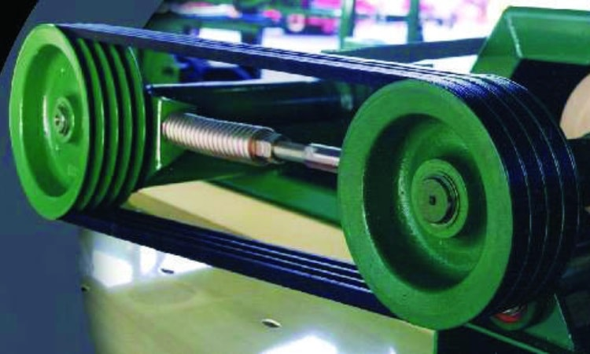
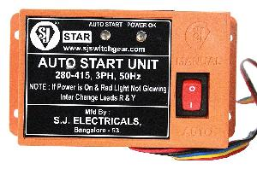
ECO’s
1.MOTORS
High efficiency motors will offers 4.5% higher efficiency than standard motors
If rewinding is not done properly, the efficiency will reduce by 5.8%
Replace V belt by Flat belt drives
Unbalanced voltage can reduce 3.5% in the motor input power.
Motor underloaded (<35% of rated output) drawing power at Low Power Factor then efficiency is very low due to high magnetic losses.
Example:
INVESTMENT:
AUTO STAR DELTA CONTROLLER = 1000Rs
Total Motors = 12
So, 12* 1000 = 12000Rs
Payback period = Investment / Annual savings *12
=12000/485646*12
= 1 Month (< 30 days)
Actual Load = 119KW,
Total days running = 340,
Total Working hr/day = 24
Annual units= 119*340*24
= 871040 Units
Power saving (due to AUTO DELTA STARTER) = 25%
If Rs.2.00/unit = 4.85 Lakhs/year

Slide 17

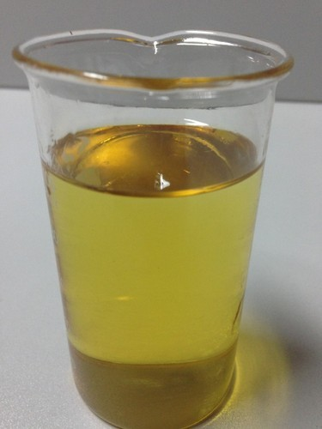
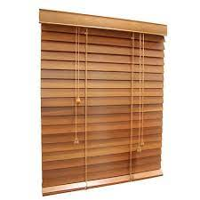
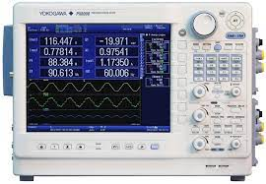
Contd..,
2.TRANSFORMER
Run two transformer in parallel to operate them at their best efficiency range it saves copper loss.
3.DG SETS
Use the super kerosene instead of diesel
Install energy saver (Magnetic Resonators)
4.Venetian Blinds for the windows in AC rooms provides more efficiency.
5.Using power analyser analyse the distortion/harmonics
(due to non linear loads)

Slide 18
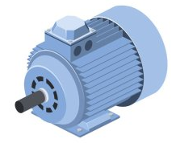

1
ENERGY EFFICIENT EQUIPMENT’S(ECO’S)
2
INSTALLING SOLAR AND WIND PLANT
3
GEP – GOOD ENGINEERING PRACTICES
REACTIVE MAINTENANCE
REPAIR
RUN
DOWNTIME - UNPLANNED
RUN
PREVENTIVE MAINTENANCE
REPAIR
REPAIR
RUN
DOWNTIME - UNPLANNED
RUN
DOWNTIME - UNPLANNED
RUN
PREDICTIVE MAINTENANCE
REPAIR
Fault Alert!
DOWNTIME - UNPLANNED
RUN
RUN

Slide 19
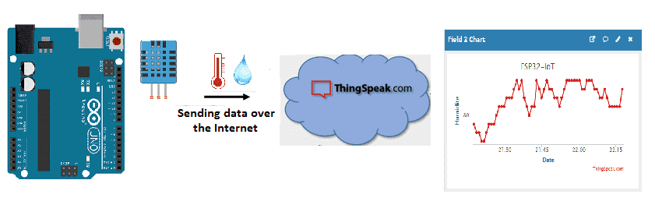
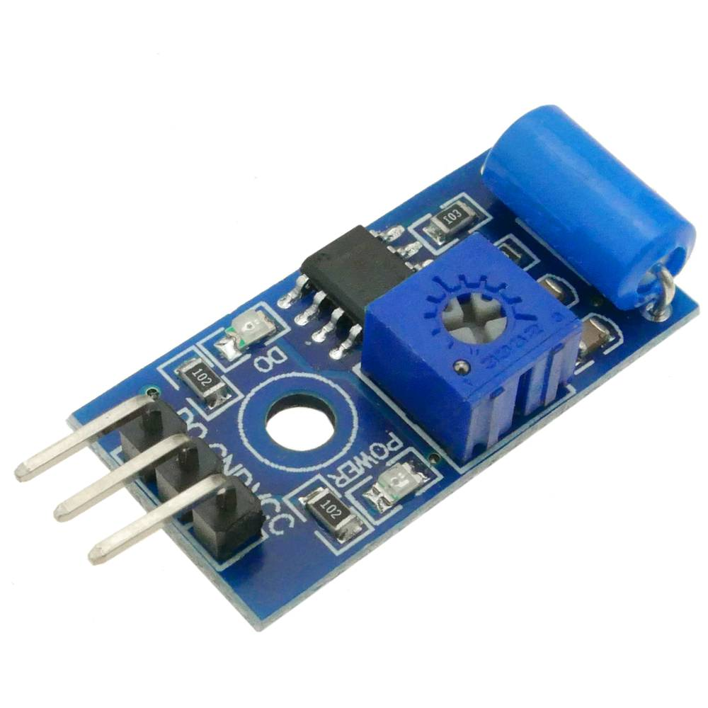
PROCESS OF VIBRATION ANALYSIS
vibration sensor
(collects vibration signals)

Slide 20
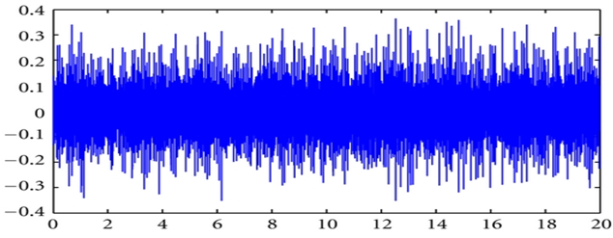

Contd..,
vibration sensor
(collects vibration signals)
AMPLITUDE
TIME
CLASSIFICATION OF FAULTS IN FREQUENCY SPECTRUM
(IDENTIFY THE TYPE OF FAULTS)
AMPLITUDE
ADASH ISO 10816 STANDARDS (TELLS US THE SEVERITY OF FAULTS)
VELOCITY THRESHOLD
(overall machine condition)
LOW FREQUENCY
MID FREQUENCY
HIGH FREQUENCY
VERY HIGH FREQUENCY
IMBALANCE, MISALIGNMENT,LOOSNESS
PUMP, COMPRESSOR,
FAN BLADES
GEARS,
ROTOR BARS,
STATOR SLOTS
CAVITATION, LUBRICATION, BEARINGS
ACCELERATION THRESHOLD
(bearing condition)
10 1000 20000
FREQUENCY (HERTZ)
These vibrations are measured in
These vibrations are measured in
VELOCITY (mm/s) or (in/s)
ACCELERATION (g)
NOTE: Velocity is more sensitive to low frequency vibration and acceleration is more sensitive to high frequency vibrations
CONDITION OF THE MACHINE
UNACCEPTABLE, UNSATISFACTORY, GOOD

Slide 21


ADASH ISO 10816 STANDARDS (TELLS US THE SEVERITY OF FAULTS)
ACCELERATION THRESHOLD
(bearing condition)
VELOCITY THRESHOLD
(overall machine condition)
CONDITION OF THE MACHINE
FAULT ALERT!
MAINTANACE NEEDED
UNACCEPTABLE, UNSATISFACTORY, GOOD

Slide 22
BLOCK DIAGRAM
Motor integrated with vibration sensor
Wi-Fi module
microcontroller
Lag the data in IoT platform
TCP/IP
Notified to users
If sensor data reaches threshold
FFT analysis
HTTP

Slide 23
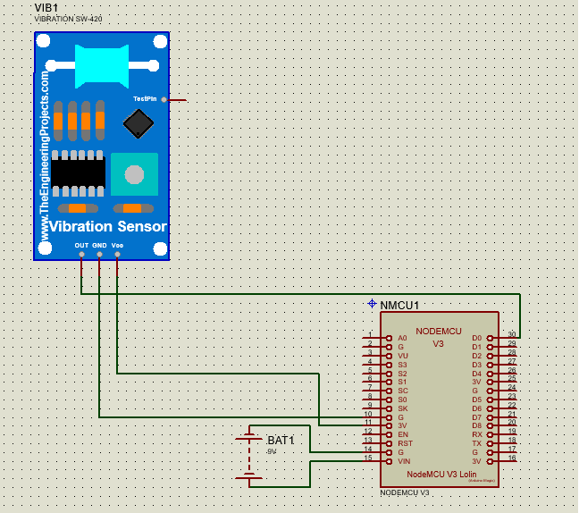
CIRCUIT DIAGRAM

Slide 24

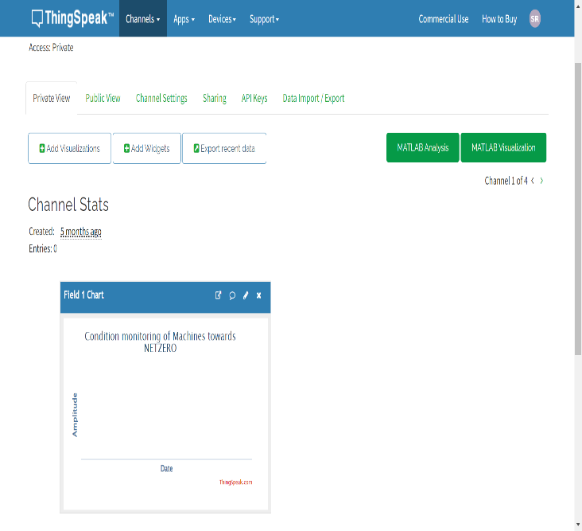
THINGSPEAK IOT PLATFORM

Slide 25
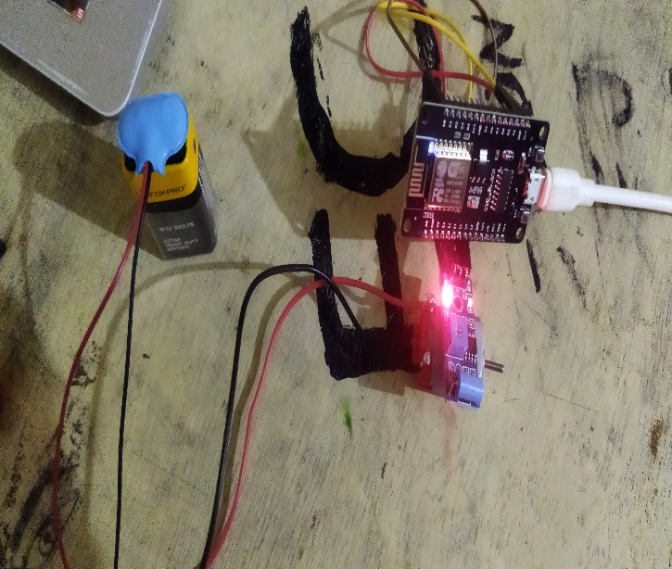
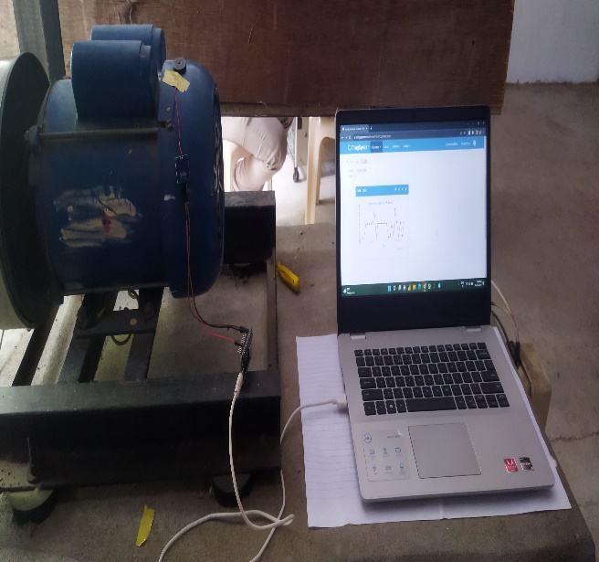
EXPERIMENTAL SETUP

Slide 26
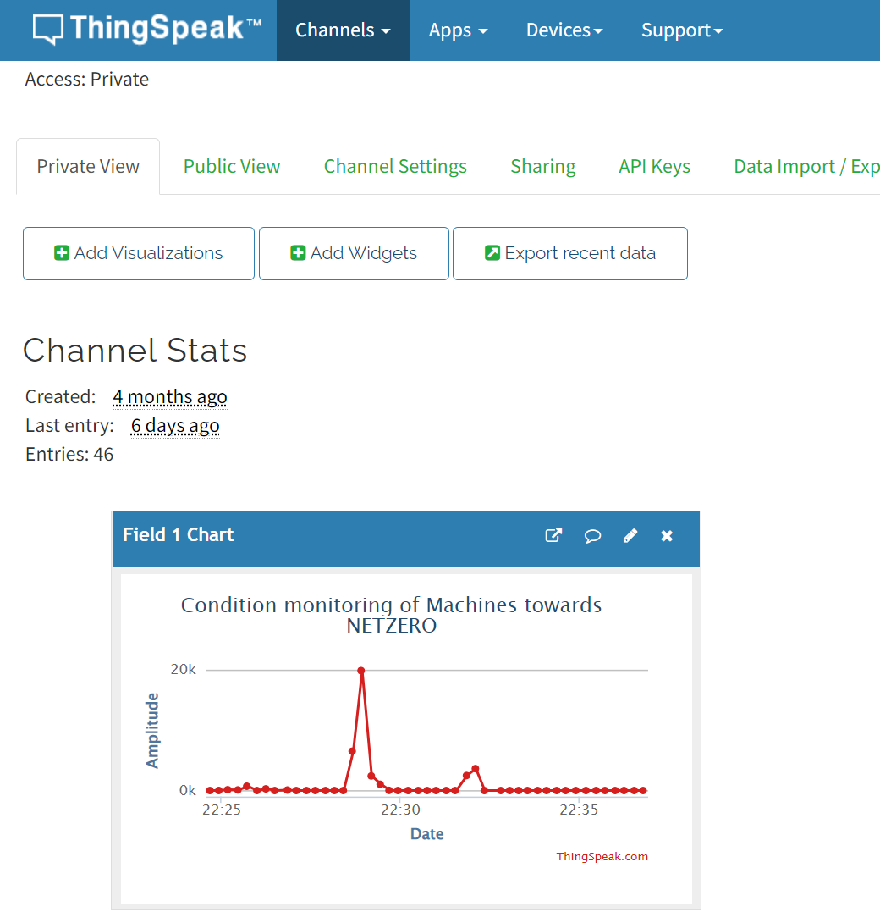
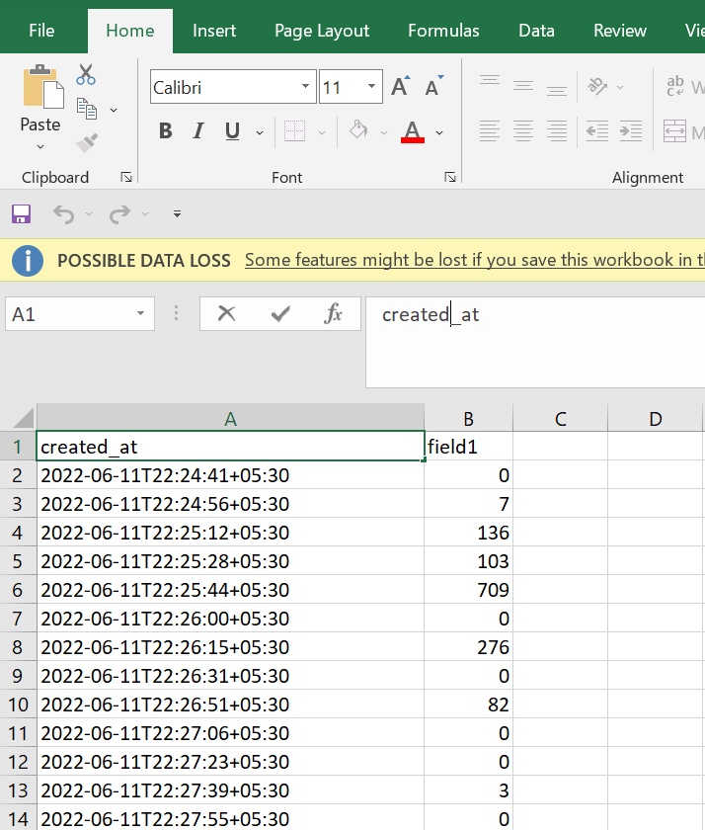
LOG THE DATA ON THINGSPAEK

Slide 27
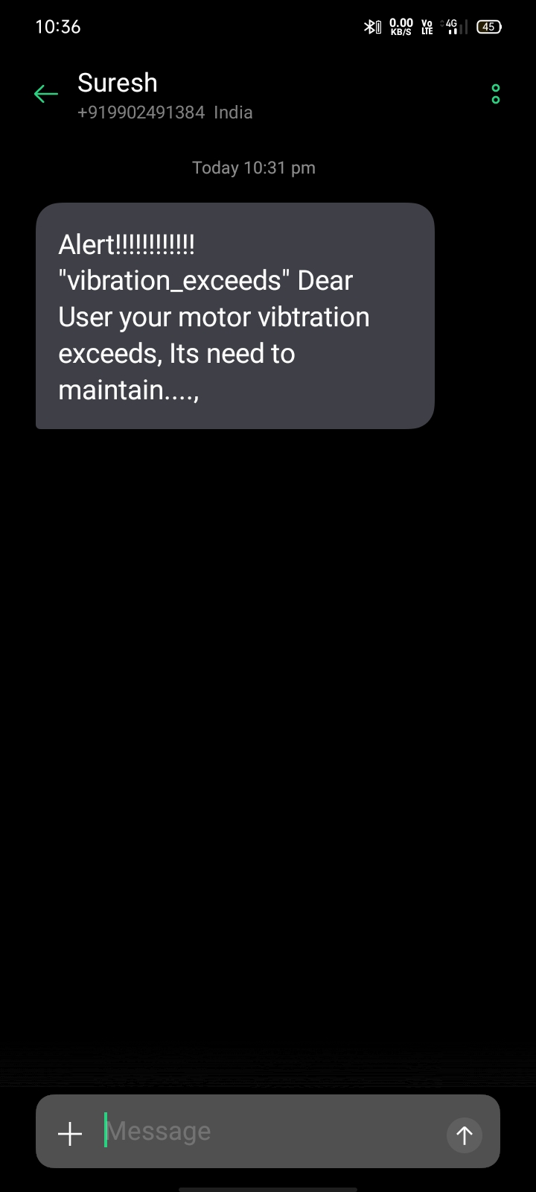
ALERT MESSAGE TO USERS

Slide 28
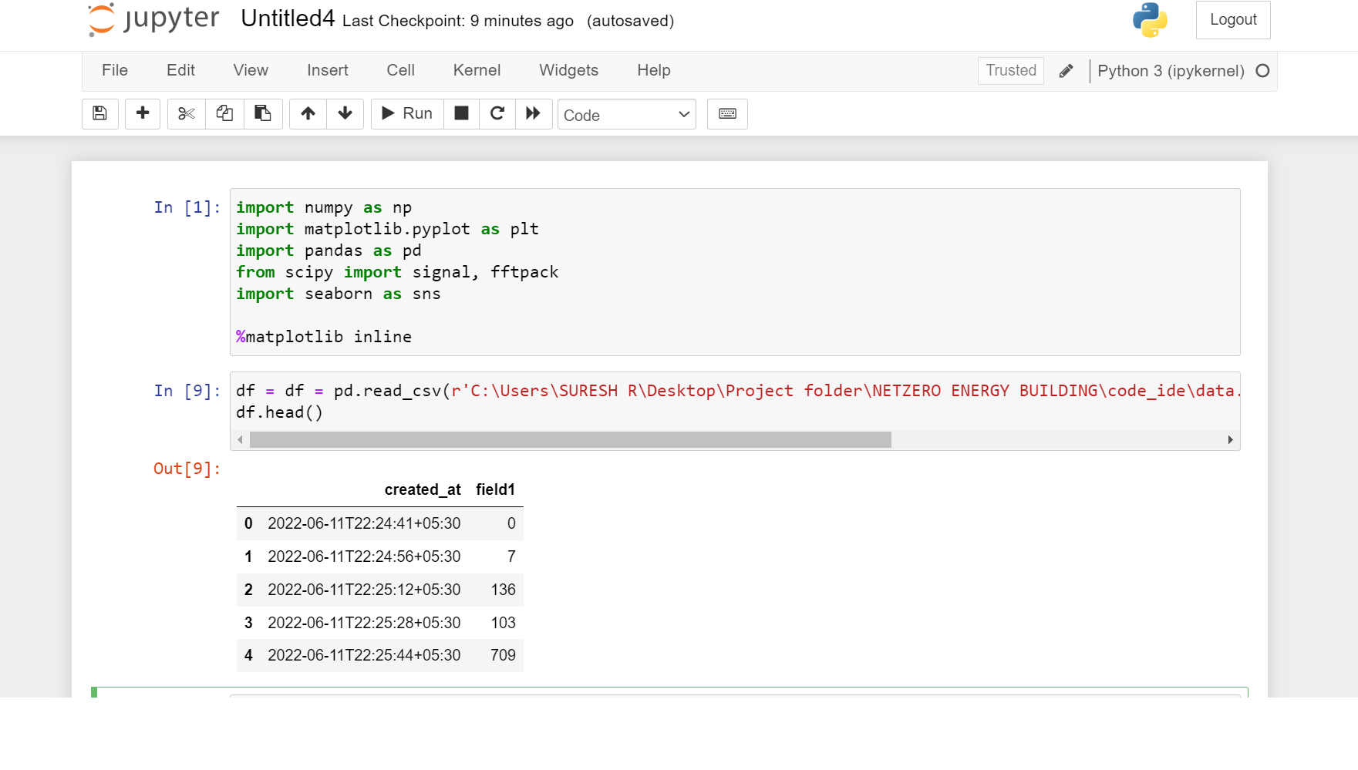
FFT

Slide 29
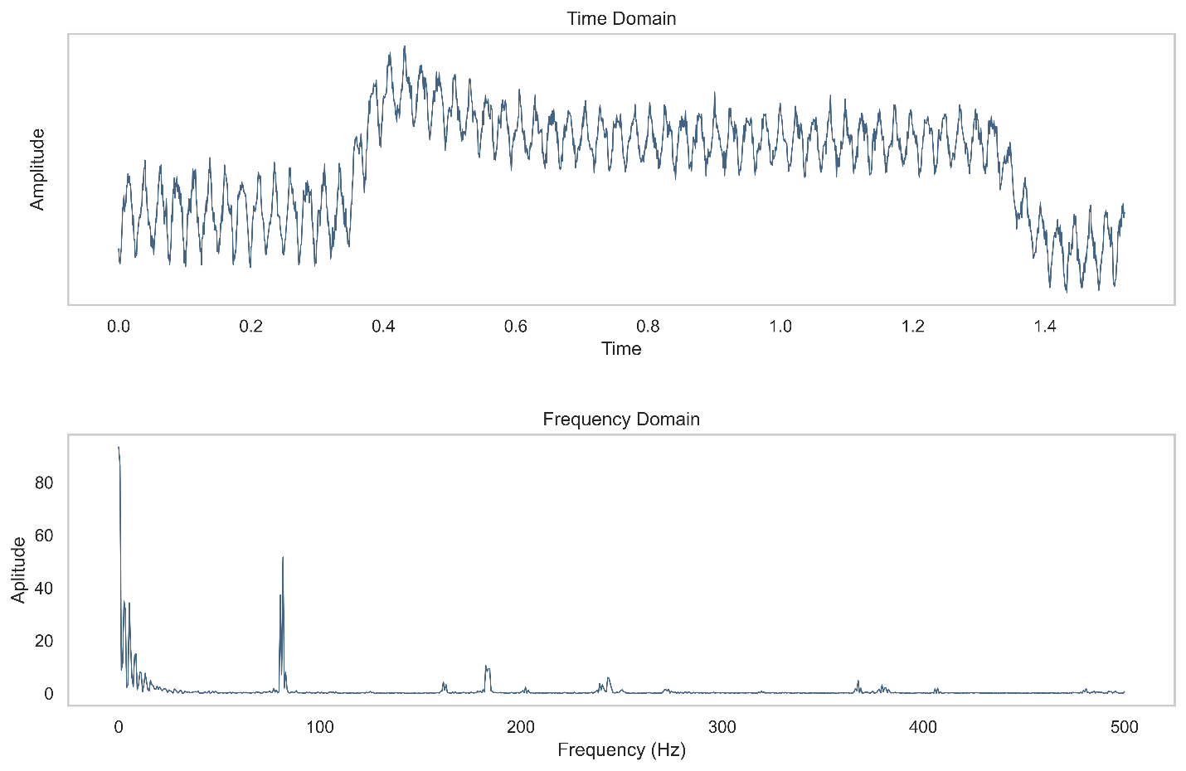
FFT

Slide 30
FUTURE SCOPE
Industries have actually adapted various technologies to increase the productivity and profits.
The Industry 1.0 came on the 18th century where, instead of items being produced by basic means, processes were invented and allowed items to be produced by machines.
Then, Industry 2.0 focused on imposing electrical technologies in the industries.
Industry 3.0 actually focused on automate processes using logic processors and information technology.
Now, most of the industries have stepped into the Industry 4.0 which mainly focusses on digital technology from recent decades to a whole new level with the help of interconnectivity through the Internet of Things (IoT), access to real-time data, and the introduction of cyber-physical systems.
This project “VIBRATIONAL ANALYSIS OF MOTOR” will actually comes under Industry 4.0 by which, industries can able to prevent their machines by predicting the fault before it occurs using the IOT technology.
This will definitely increase the productivity and the economy of the country, if we implement this in the industries in our country.

Slide 31
CONCLUSION
Thus the main intent of this project is to make the NET ZERO ENERGY CONSUMPTION practically possible by undergoing certain ecos, which paves the way to attain the net zero energy path.
Under Good Engineering Practices, there are three types of maintanence techniques for the machines. One of the important maintanence is the predictive maintanence.
The main intention of this maintanence technique is to predict the fault of the machine before it occurs, so that, the equipment can be saved from being damaged because of the fault.
Moreover, the power consumption will be suddenly increased due to the sudden fault of the machine. So, if we predict that particular fault before it occurs, then we can prevent the additional power consumption of the equipment because of the fault.
This technique can actually be done using IOT technology. Using Vibration sensor, the vibration of the motor was analysed and the data is sent to the Thingspeak IOT platform with the help of the ESP wifi module.
With that data, we can actually able to analyze which part of the motor is faulty, so that, we can focus on that part alone instead of focussing on the whole motor.
This method was actually implemented with the AC induction motor of CKEC, and the Vibration data was obtained and stored in Thingspeak cloud. With the difference in the waveform, the fault of the motor can be easily analyzed.

Slide 32
REFERENCE
Peter Tanver, Li Ran, Jim Penman & Howard Sedding, “Condition Monitoring of Rotating Electrical Machines”, Institute of Engineering & Technology, London,2008
A. Ajitha, D. Swathi, J. Laxmi Prasanna and D. Shyamala, “IoT platform for Condition Monitoring of Industrial Motors”, 2nd International Conference on Communication and Electronics systems, 2017
E. Akin, I. Aydin, & M. Karakose, “FPGA Based Intelligent Condition Monitoring of Induction Motors: Detection, Diagnosis, and Prognosis”, IEEE International Conference on Industrial Technology, pp. 373 - 378, 2011.
Abdelelah Almounajjed, Ashwin Kumar Sahoo, Mani Kant Kumar, Mhamad Waleed Bakro, "Condition Monitoring and Fault Diagnosis of Induction Motor - An Experimental Analysis"7th International Conference on Electrical Energy Systems (ICEES) – 2021
Swapnil Dol and Raunak Bhinge "SMART Motor for Industry 4.0" IEEE publications 2018
Xin Xue, V. Sundararajan and Wallace P. Brithinee "THE APPLICATION OF WIRELESS SENSOR NETWORKS FOR CONDITION MONITORING IN THREE-PHASE INDUCTION MOTORS" 978-1-4244-0448-91071$26.00 @20071EEE.
Ravi C. Bhavsar, Rakeshkumar A. Patel AND Dr. B.R. Bhalja "Condition Monitoring of Induction Motor using Artificial Neural Network" International Conference on Magnetics, Machines & Drives (AICERA-2014 iCMMD)

Slide 33
Thank you

